Slide 1
Employee Attendance Management System
Authors- Anjali, Purva and Shyamala
Mentor – Annu Sharma

Slide 2
Problem Statement
Managing Employee Attendance is very important for all kind of employers.
There are several issues with paper based Attendance Management System.
Risk of human error
Time consuming
Difficult to manage and track
We believe technology can play a great role in solving these pain points and hence a requirement arose for
Digital Employee Attendance management system.

Slide 3
User Stories
As an admin I should be able to add, remove and update Employee details.
As a supervisor I should be able to access attendance details of Employees.
As an Employee I should be able to mark my attendance.

Slide 4
Approach
Browsed a few Staff Attendance Management Systems over internet.
Took help from Stackroute mentor Annu Sharma.
Divided the task among team mates.

Slide 5
Design
Admin
Employee Details Microservice
Add/Delete/
Update/Retrieve
Supervisor
Attendance Details Microservice
Retrieve Employee Attendance
Employee
Attendance
Details Microservice
Mark and update Attendance

Slide 6
Microservice Design
Employee Service
Attendance Service
Mainclass
Mainclass
Presentation Layer
Employee controller
Get, Post, Put and Delete
Employee Service
Employee ServiceImpl
Persistence Layer
Employee Model
Service Layer
Employee Repository
Presentation Layer
Attendance Controller
Get, Post, Put and Delete
Service Layer
Attendance Service
Attendance ServiceImpl
Persistence Layer
Attendance Model
Attendance Repository
Database
Database

Slide 7
Project Demo

Slide 8
Conclusion
Digital Attendance Employee Management System will –
Help in preventing payroll errors
Improve efficiency and productivity
Eco-friendly

Slide 9
Key Learnings
Spring
Spring Boot
MySQL
Rest APIs
Annotations
Management
Networking
Communication
Teamwork

Slide 10


Slide 11
Appendix

Slide 12
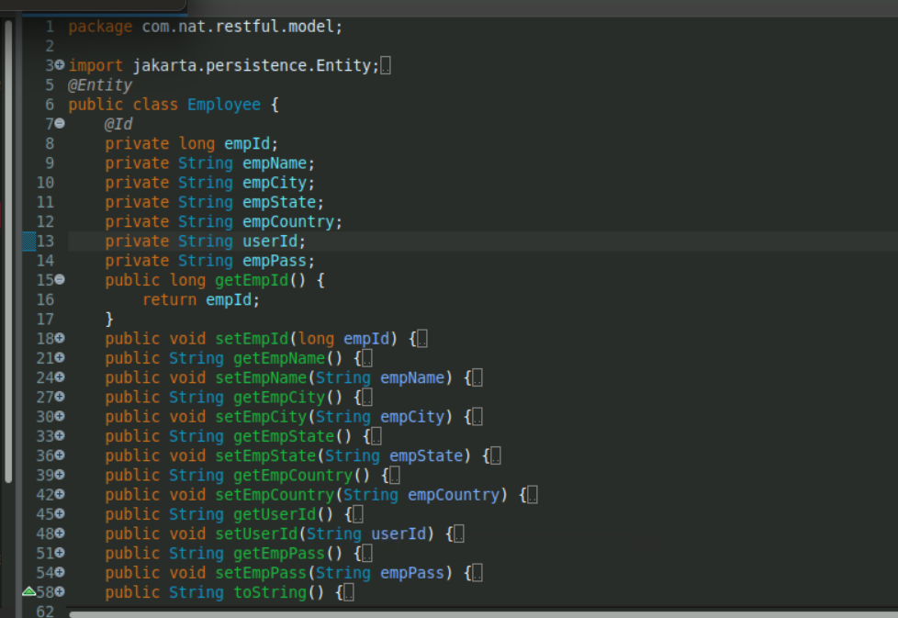

Slide 13
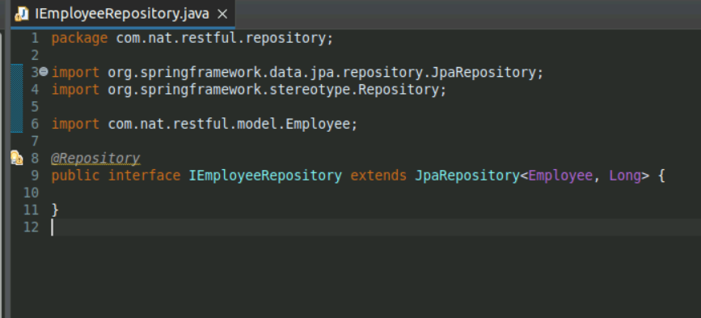

Slide 14
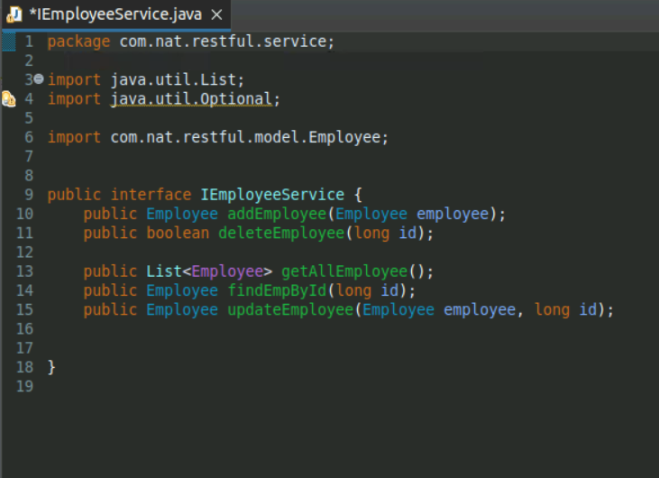

Slide 15
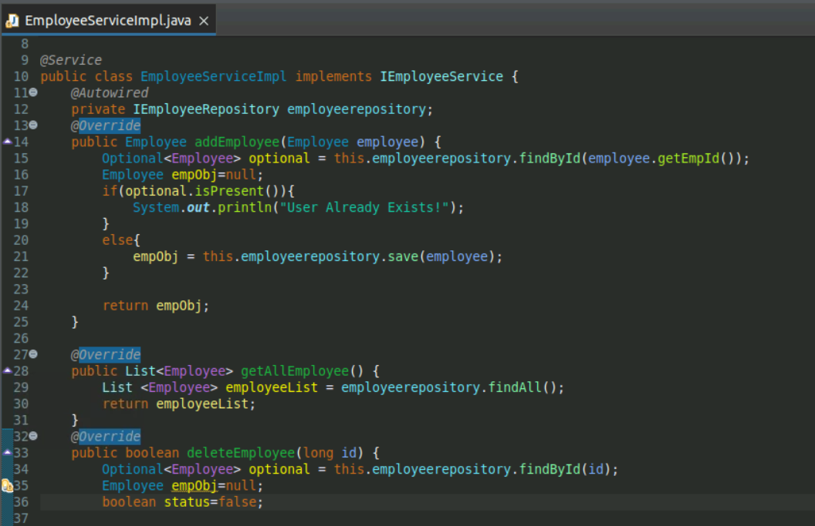

Slide 16
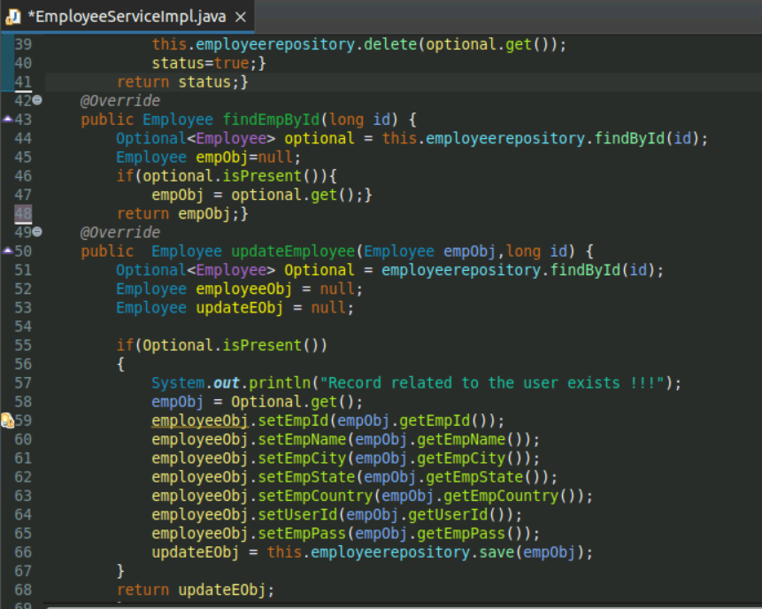

Slide 17
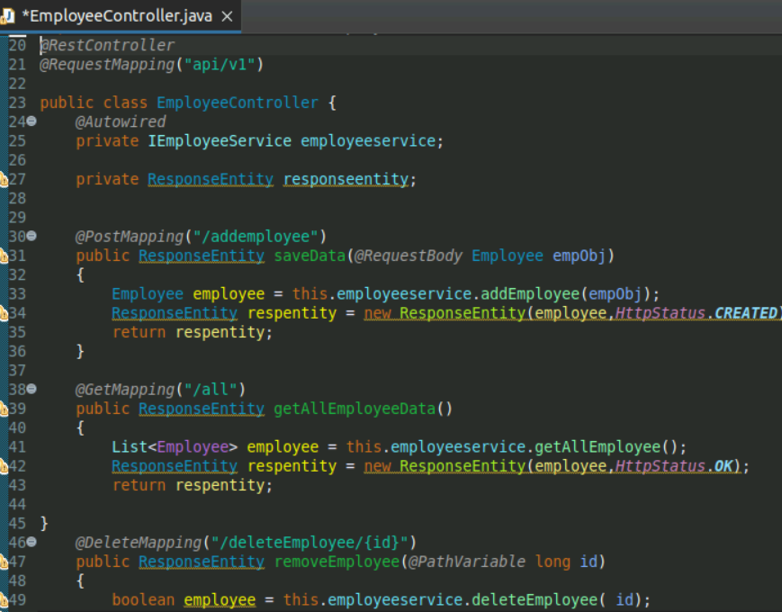

Slide 18
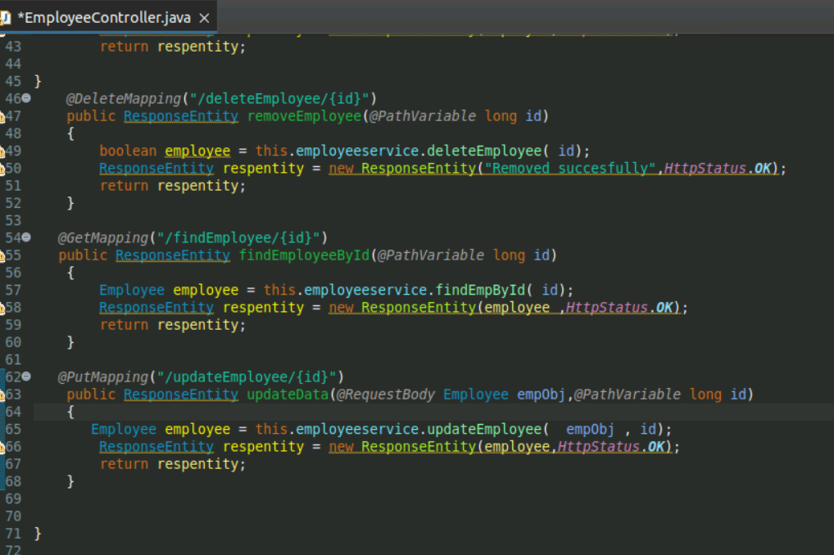

Slide 19
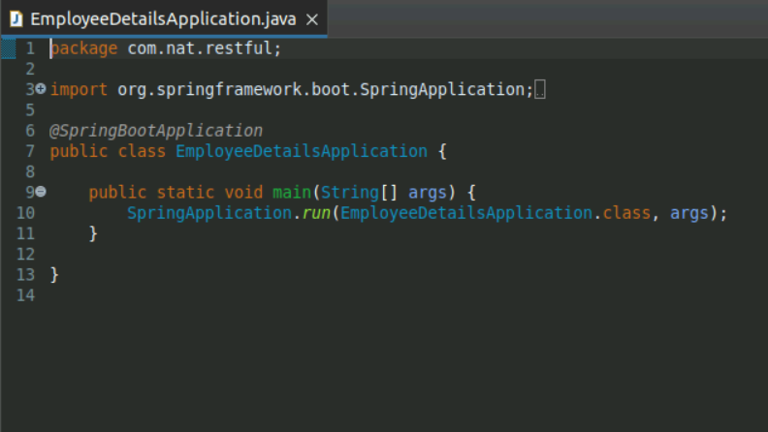

Slide 20
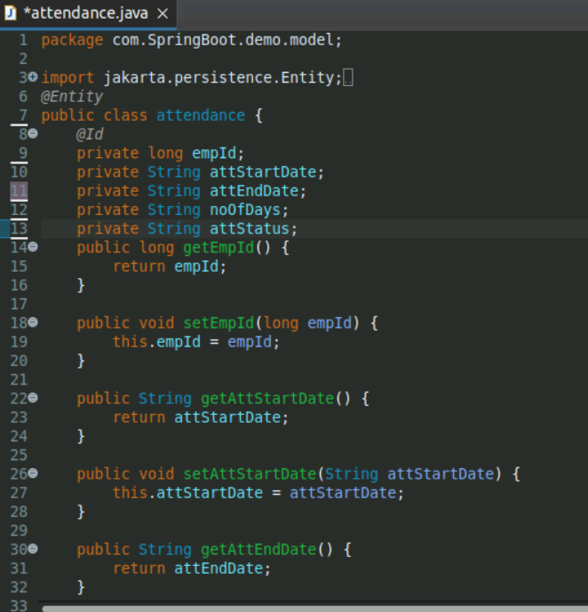

Slide 21
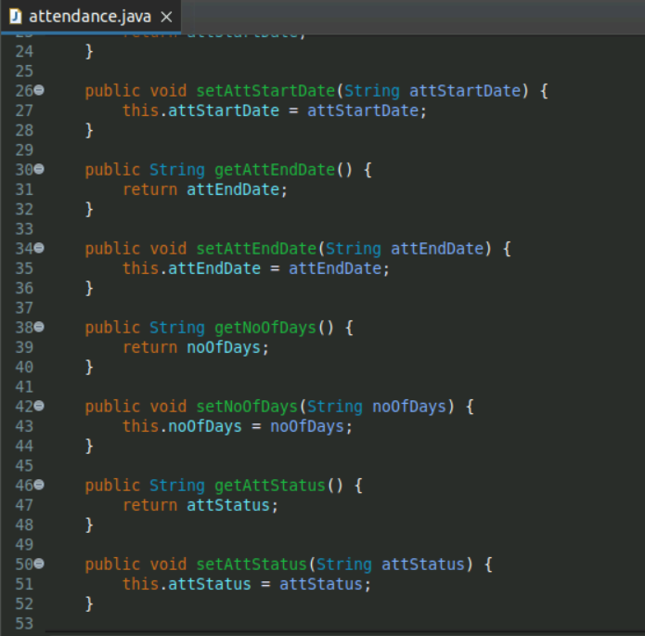

Slide 22
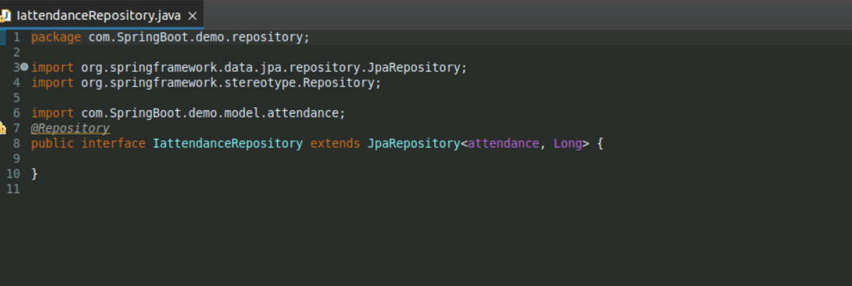

Slide 23
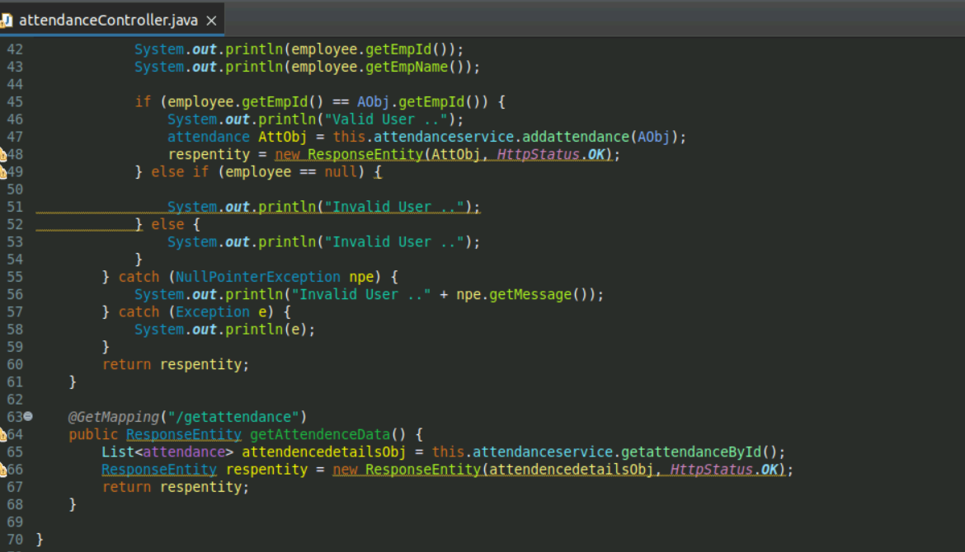

Slide 24
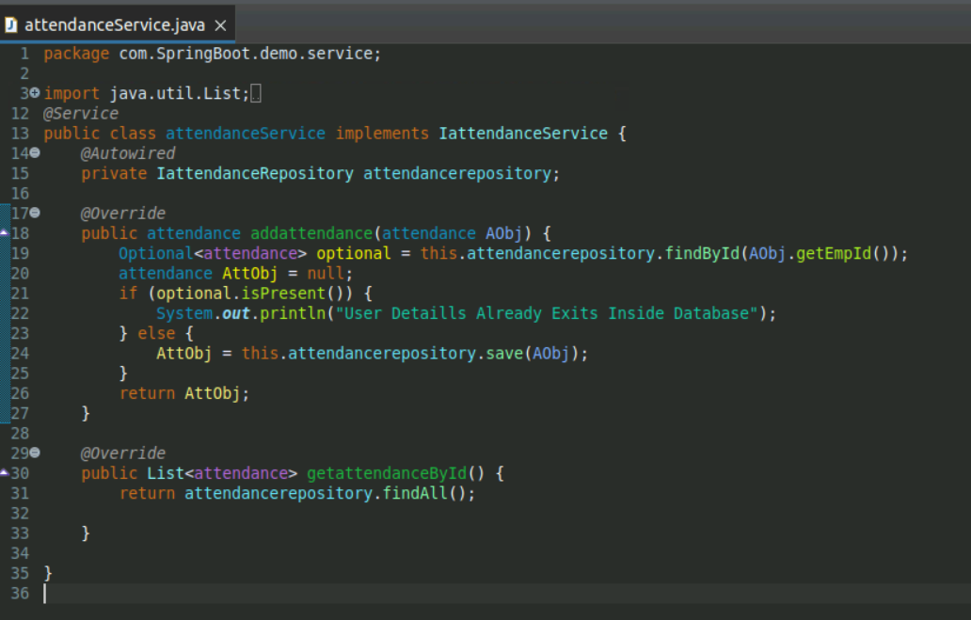

Slide 25
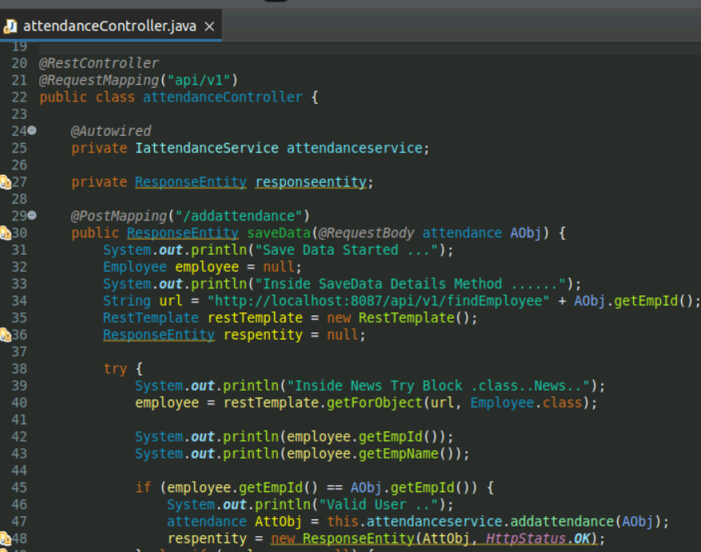

Slide 27
